Slide 1

Consumer Behavior & Business Insights
Driving Retention and Revenue through Data-Driven Analysis
This project presents an in-depth analysis of anonymized e-commerce transaction data. Our goal is to understand complex customer behaviors, identify high-value segments, and provide actionable insights to support strategic decision-making in the e-commerce landscape. This forms a key part of a DBA Application as a Flagship Project.

Slide 2
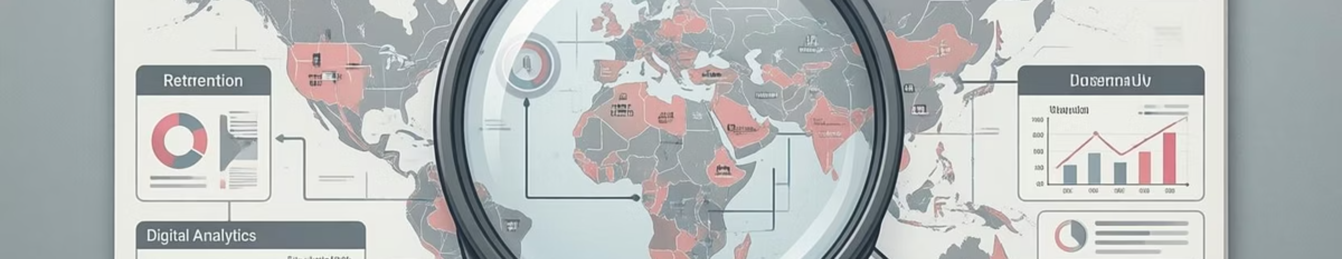
The Business Challenge: Retention Over Acquisition
In today's competitive e-commerce environment, sustainable growth increasingly hinges on customer retention rather than solely on new customer acquisition.
Management often lacks clarity on which customers generate the most long-term value.
There's insufficient understanding of how purchasing behavior varies across different customer groups.
Key drivers behind repeat purchases and sustained engagement remain unclear.
This gap means critical decisions are often made without a comprehensive view of customer behavior and where true value is concentrated.

Slide 3
Project Objectives: What We Aimed to Achieve
1
2
Identify Customer Segments
Compare Engagement & Value
To pinpoint distinct customer groups based on their unique purchasing patterns.
To assess the engagement levels and monetary value contributed by each identified segment.
3
4
Understand Repeat Purchase Drivers
Actionable Recommendations
To uncover the behavioral factors that encourage customers to make recurring purchases.
To translate complex analytical insights into clear, strategic business recommendations.

Slide 4


Dataset Overview: The Foundation of Our Analysis
Our analysis was built upon a robust dataset of anonymized e-commerce transaction data. This rich source provided the granular detail necessary for a deep dive into customer behavior.
Customer ID
Order / Invoice ID
Order Date
Product Category
Quantity & Price
Country
This comprehensive data structure was ideal for enabling customer-level behavioral analysis, directly supporting retention, segmentation, and value assessment.

Slide 5
Key Business Metrics: Baseline Performance Snapshot
Before diving into behavioral patterns, we established a clear baseline by examining several key performance indicators (KPIs) to provide essential business context.
1.2M
3.5M
$150M
$42.85
Total Customers
Total Orders
Total Revenue
Avg. Order Value
Our full customer base over the analysis period.
Aggregate number of transactions processed.
Overall sales generated from all orders.
The typical value of a single customer order.
2.9
Orders per Customer
Average number of orders placed by each customer.
These metrics provide a foundational understanding of our operational scale and financial performance before deeper dives into individual customer behaviors.

Slide 6
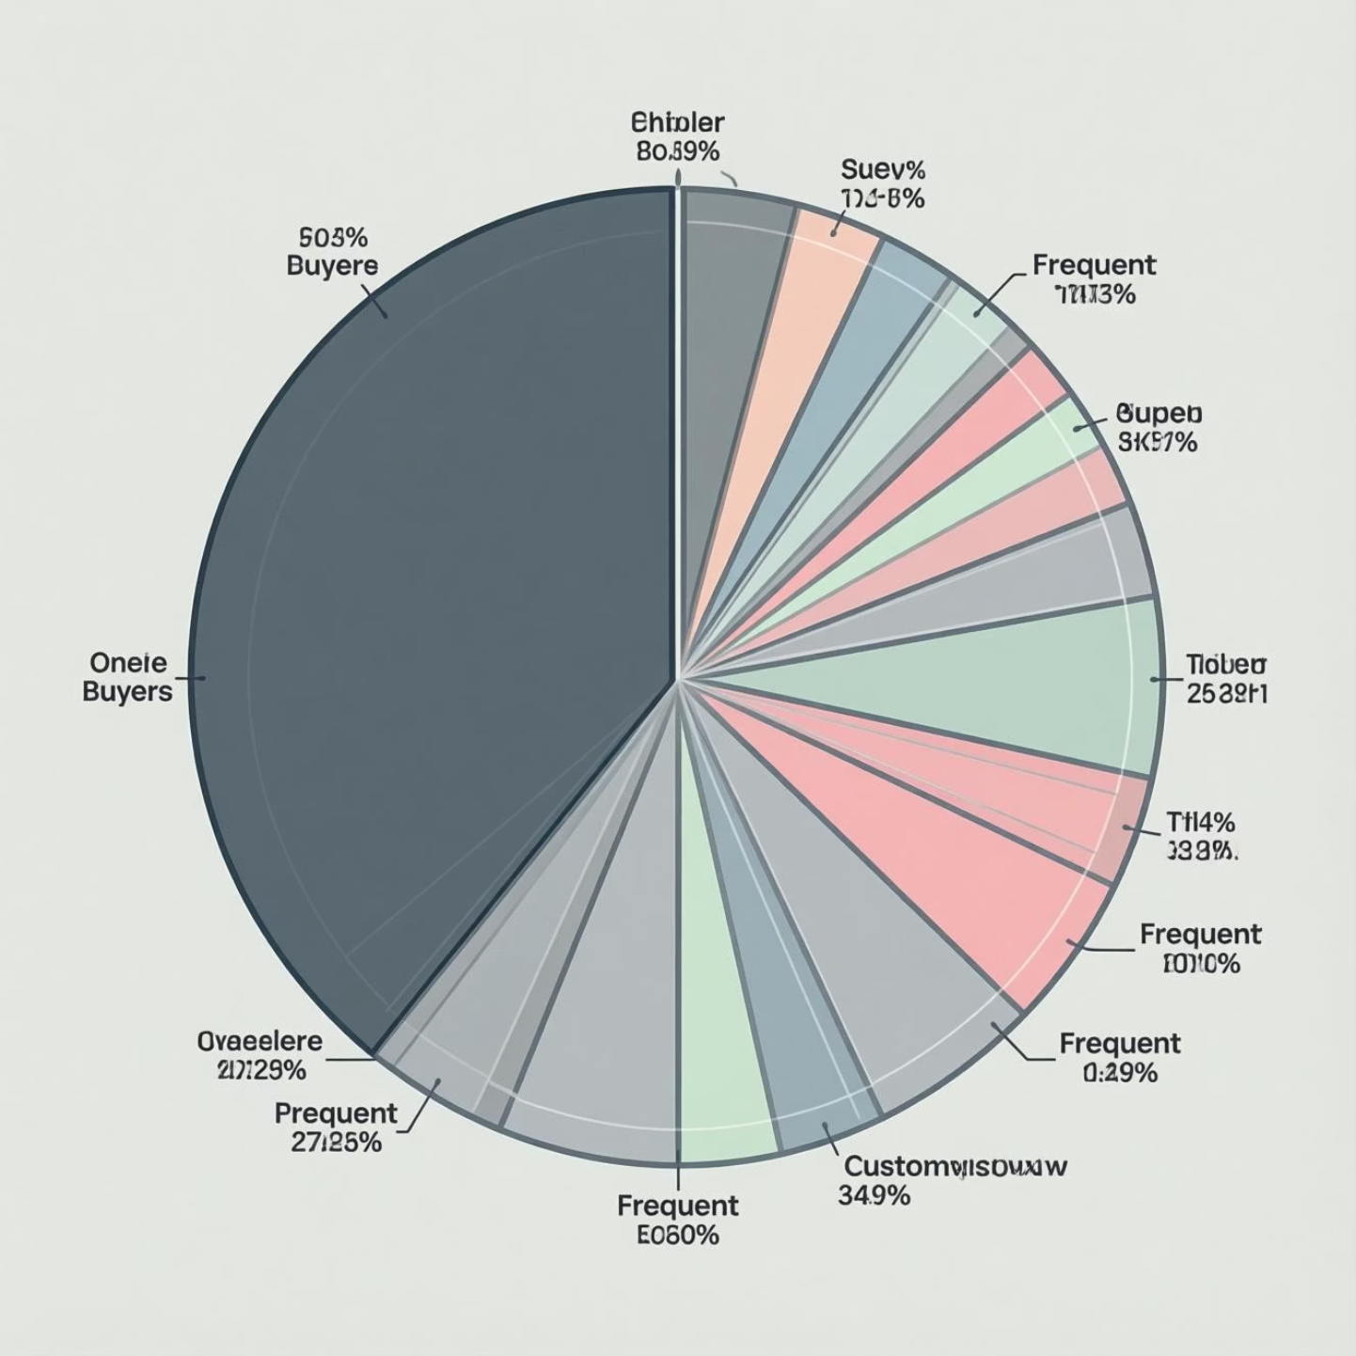

Customer Behavior Overview: How Customers Actually Behave
Purchase Frequency Analysis
A significant portion of our customer base consists of one-time buyers.
Frequent buyers, while a smaller group in terms of count, are highly engaged.
Revenue Contribution
Crucially, these frequent buyers contribute a disproportionately high share of the total revenue.
This indicates a classic "Pareto principle" at play in our customer base.
Key Insight:
A small, dedicated segment of customers drives a majority of the business's overall value. This concentration is vital for strategic focus.

Slide 7




Customer Segmentation: Grouping by Behavior
To tailor our strategies, we segmented customers based on three critical behavioral dimensions:
Purchase Frequency
Total Spending
Recency
How often a customer places orders.
The cumulative monetary value of their purchases.
How recently a customer made their last purchase.
This segmentation revealed four key customer archetypes:
High Value – High Frequency
High Value – Low Frequency
Low Value – High Frequency
One-Time Buyers
Understanding these distinct segments is paramount, as each requires a different, tailored engagement strategy.

Slide 8
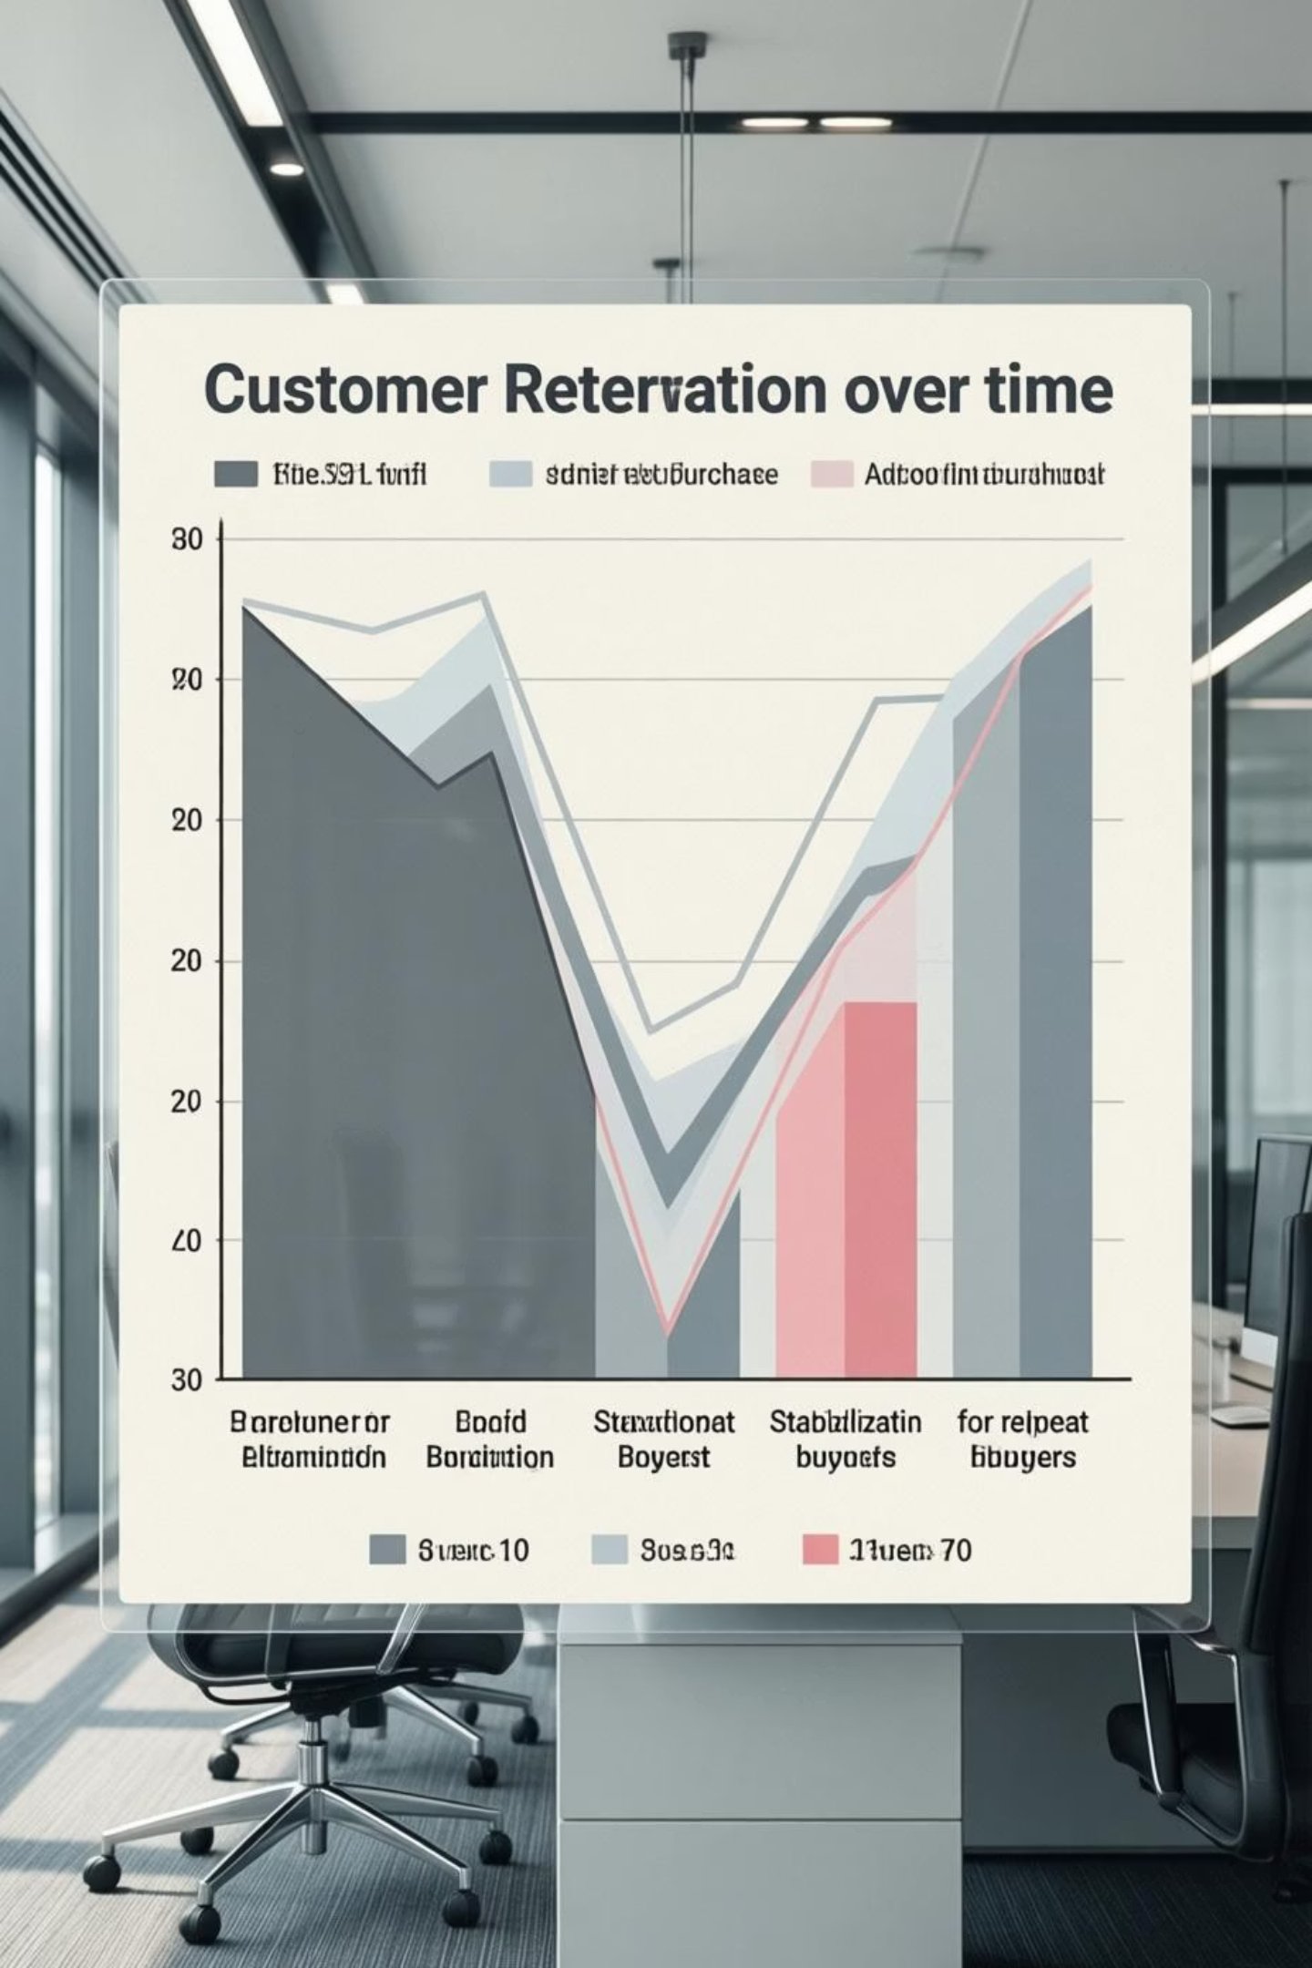
Retention & Repeat Purchase Behavior: Driving Long-Term Engagement
Our analysis uncovered crucial observations regarding customer retention and the dynamics of repeat purchases:
Repeat customers consistently demonstrate a significantly higher Lifetime Value (LTV) compared to one-time purchasers.
The timing and occurrence of early repeat purchases show a strong correlation with long-term retention. Customers who make a second purchase soon after their first are far more likely to stay.
Conversely, extended periods of inactivity drastically increase the risk of customer churn.
Key Insight: The second purchase represents a critical milestone in the customer journey, often serving as a strong predictor of long-term retention and loyalty.

Slide 9
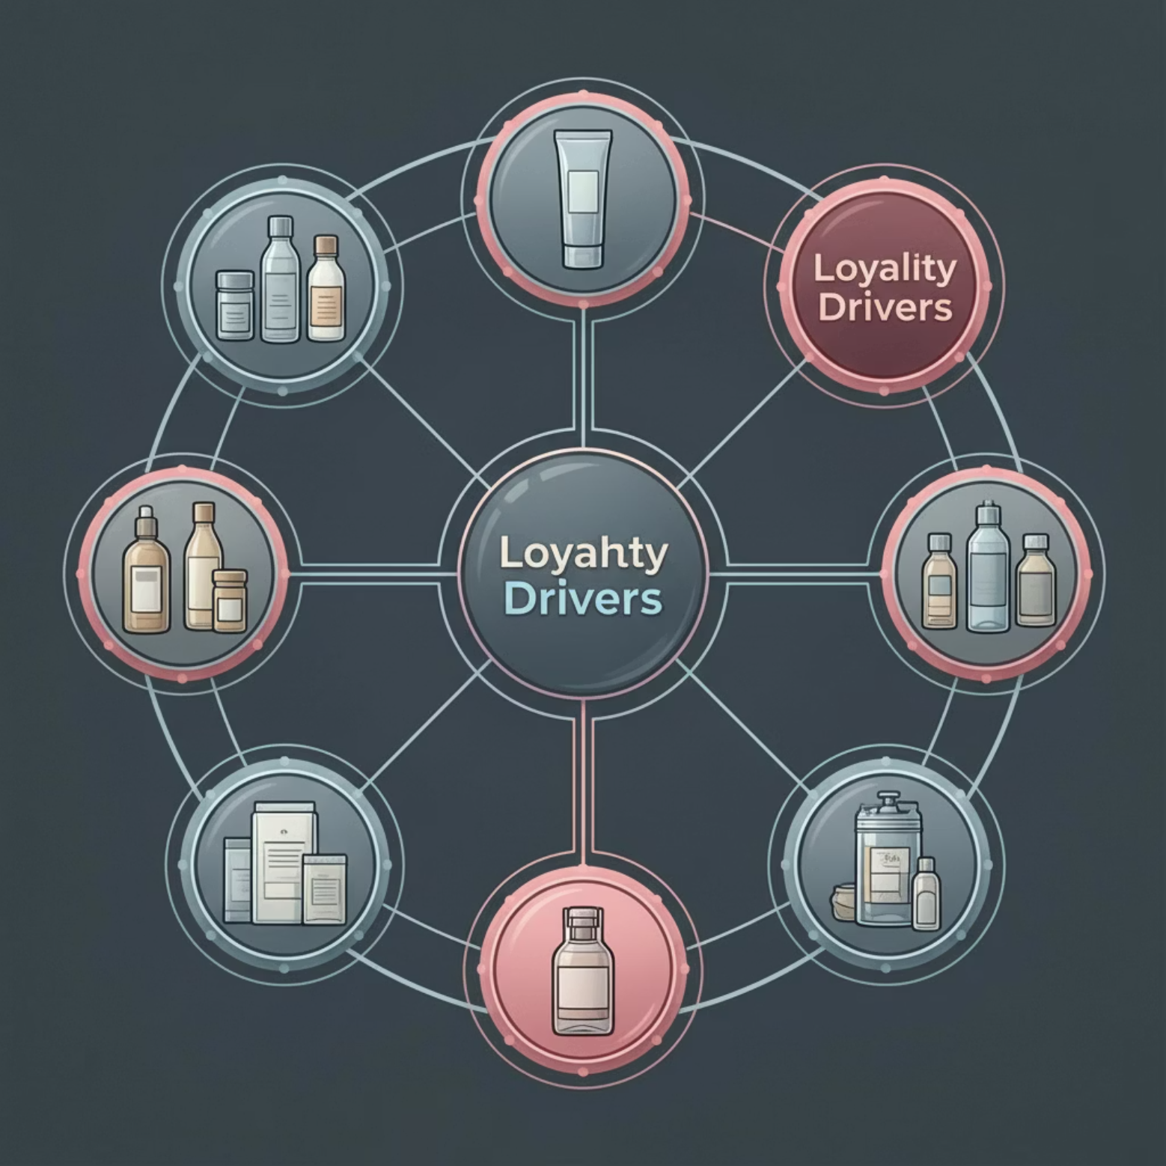
Product & Category Insights: Products That Drive Loyalty
Delving deeper into product data revealed nuances beyond just revenue:
Not all high-revenue product categories are equally effective in driving customer retention. Some categories, despite high sales, contribute less to repeat business.
Conversely, certain product categories are strongly associated with a higher propensity for repeat purchases, acting as 'loyalty magnets.'
Loyal, high-value customers tend to concentrate their spending within a narrower range of categories, indicating specialized interests or needs being met.
Implication: Retention strategies should be product-led, focusing on identifying and promoting categories that inherently foster loyalty, rather than solely chasing volume across all products.

Slide 10

Key Insights Summary: What the Analysis Revealed
Concentrated Revenue
Repeat Buyer Value
A small, but highly engaged group of customers drives the majority of our business revenue.
Repeat buyers deliver significantly higher lifetime value, underscoring their importance over one-time purchasers.
Early Engagement Matters
Product-Driven Loyalty
The earliest stages of the customer journey, particularly the second purchase, critically influence long-term retention outcomes.
Specific product categories act as powerful retention drivers, warranting targeted strategic focus.

Slide 11




Key Insights Summary: What the Analysis Revealed
Our analysis uncovered critical findings that define the strategic path forward for customer retention and value maximization:
Concentrated Revenue
Repeat Buyer Value
A small, highly engaged group of customers drives the majority of our business revenue.
Repeat buyers deliver significantly higher lifetime value, underscoring their importance over one-time purchasers.
Early Engagement Matters
Product-Driven Loyalty
The earliest stages of the customer journey critically influence long-term retention outcomes.
Specific product categories act as powerful retention drivers, warranting targeted strategic focus.
These actionable insights highlight precisely where management attention and resources should be concentrated to maximize retention and revenue.

Slide 12




Strategic Recommendations
Based on our analysis, we propose the following actionable strategies to enhance customer retention and drive sustainable growth:
Segment-Based Engagement
Retention-Focused Marketing
Focus loyalty initiatives and personalized experiences on our high-value and frequent customer segments.
Reallocate marketing spend from broad customer acquisition to targeted campaigns designed to retain existing customers.
Product-Led Retention Strategy
Early Engagement Programs
Identify and actively promote product categories that have proven to be 'loyalty magnets' and encourage repeat purchases.
Implement initiatives to encourage customers to make a second purchase shortly after their initial transaction, a key predictor of long-term retention.

Slide 13




Estimated Business Impact: Expected Outcomes
If implemented effectively, these strategies can lead to:
Improved Customer Retention
Higher Customer Lifetime Value (CLTV)
Strengthening customer loyalty and reducing
churn rates.
Maximizing the long-term revenue generated from each customer.
More Predictable Revenue Streams
Better Return on Marketing Investment
Building a more stable and forecastable
financial foundation.
Optimizing marketing spend for greater efficiency and impact.
Significant Long-Term Value
Even small improvements in retention can generate significant long-term value, compounding over time.

Slide 14


Key Learnings & Reflection
This project effectively demonstrated:
Structured Problem-Solving
Executive Insights
Business-Focused Analytics
Transforming raw data into clear, actionable recommendations for leadership.
Navigating complex challenges with a methodical, data-driven approach.
Delivering analytical support directly aligned with strategic decision-making.
These capabilities are fundamental in real consulting and business leadership environments.

Slide 15



Final Takeaway
Consumer behavior data, when analyzed through a business lens, can directly inform strategic decisions around retention, revenue growth, and customer value optimization.
Data
Insight
Decision

